Slide 1
Data analytics
Session 00

Slide 2
What is Data
Data refers to raw, unprocessed information, facts, or observations that are collected, stored, and used for various purposes.
Data can take different forms and types, depending on its nature and how it's structured.

Slide 3
Data
Numerical
Categorical
Discrete
Continuous
Ordinal
Nominal

Slide 4
Data
Structured
Unstructured

Slide 5
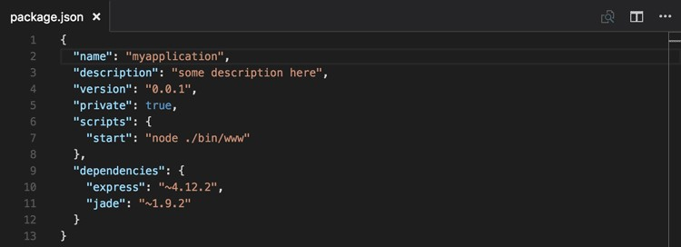
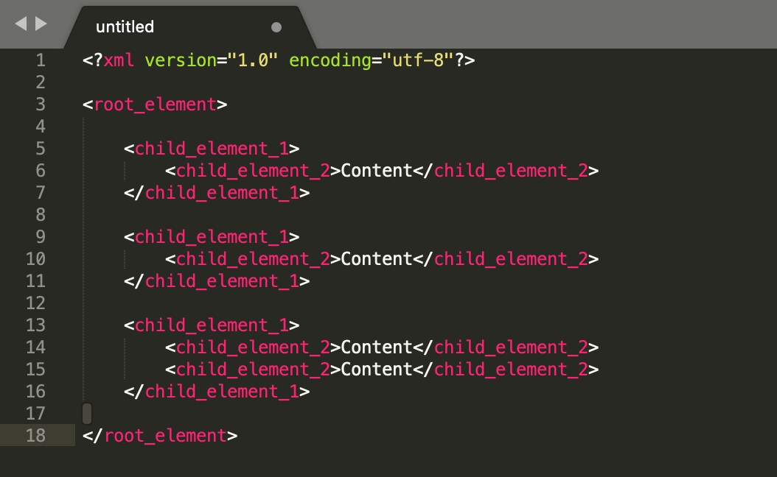
JSON
XML

Slide 6
What is Data Analytics
Data analytics is the process of examining, cleaning, transforming, and interpreting data to discover valuable insights, patterns, and trends.
It involves using various techniques and tools to analyze data with the goal of making informed business decisions, solving problems, and improving processes.
Data analytics is a multidisciplinary field that combines elements of statistics, computer science, domain expertise, and data visualization.

Slide 7
Some Aspects of Data Analytics
Data Collection: The first step in data analytics is gathering relevant data from various sources, including databases, spreadsheets, sensors, web applications, and more. This data can be structured (e.g., databases) or unstructured (e.g., text, images).
Data Cleaning and Preprocessing: Raw data is often messy, containing errors, missing values, and inconsistencies. Data analysts need to clean and preprocess the data to ensure it's accurate, complete, and suitable for analysis.
Exploratory Data Analysis (EDA): EDA involves summarizing data using descriptive statistics, data visualization, and other techniques. It helps analysts gain a preliminary understanding of the data's characteristics and identify potential patterns or outliers.
Statistical Analysis: Statistical methods are applied to test hypotheses, make predictions, and infer relationships within the data. Common statistical techniques include regression analysis, hypothesis testing, and clustering.

Slide 8
Usage
Big Data Analytics: In the era of big data, organizations analyze vast volumes of data using distributed computing frameworks like Hadoop and Spark. This allows them to extract insights from large and complex datasets.
Text and Sentiment Analysis: Natural language processing (NLP) techniques are used to analyze textual data, extract information, and perform sentiment analysis on text data from sources like social media.
Business Intelligence (BI): BI tools provide interactive dashboards and reports that allow users to explore data and gain insights without needing technical expertise.
Data Governance and Security: Ensuring data privacy, security, and compliance with regulations is a critical aspect of data analytics.
Predictive Analytics: Predictive modeling is used to forecast future trends and make informed decisions based on historical data. It's often used for sales forecasting, demand prediction, and risk assessment.

Slide 9


Programming Languages

Slide 10


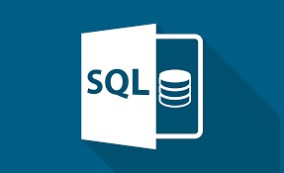

Tools

